Slide 1

Major Project Presentation
Voice Based Banking for Rural Areas
Team Members
Sushrutha Shanbhogue 4SF22CS225
Raghavendra SS 4SF22CS158
Sowndarya S 4SF22CS218
Iram A.K Shaikh 4SF23CS404
Under the Guidance of:
Mr. Raghavendra Sooda Assistant Professor,
Dept of CSE, SCEM
Department of Computer Science and Engineering
1

Slide 2
Domain of the project
This project lies at the intersection of Artificial Intelligence (AI), Natural Language Processing (NLP), and Banking and Financial Services. It leverages Microsoft Azure cloud technologies such as Speech Service, Translator Service, AI Avatar, and Azure Functions to create an intelligent, voice-driven banking solution. The system captures Kannada speech, translates it into English, and automatically fills bank forms in PDF format. By combining speech recognition, language translation, and automation, the project enhances financial accessibility for rural and regional users. It promotes digital inclusion by enabling customers to interact with banking services through natural voice communication in their local language.
Department of CSE
2

Slide 3
Abstract
The project titled “Voice – Based Banking for Rural Areas” focuses on simplifying banking access for Kannada-speaking users, especially in rural areas. It uses Azure Speech Service to capture and transcribe Kannada voice input, Azure Translator to convert it into English, and Azure Functions to fill bank forms automatically in PDF format. An interactive AI Avatar guides the user throughout the process. This integrated system eliminates language barriers, reduces manual errors, and promotes digital inclusivity by enabling users to complete banking tasks through natural voice interaction.
3

Slide 4
Contents
Introduction
Problem Statement
Objectives
Literature Survey
Project Design
System Requirements Specification
Gantt Chart
Conclusion
References
Department of CSE
4

Slide 5
Introduction
Many people in rural regions face challenges in accessing online banking due to language barriers and low digital literacy. Most banking systems operate in English, creating difficulties for native Kannada speakers. This project introduces a voice-based banking solution that allows users to fill forms using spoken Kannada.The system combines several Azure services — Speech Service, Translator, Speech Studio AI Avatar, and Azure Functions — to create a smart, automated workflow. The user speaks in Kannada, the speech is transcribed and translated into English, and the information is directly inserted into a bank PDF form.By providing an easy, accurate, and accessible method to complete banking forms, this project demonstrates how AI and cloud computing can make financial services more inclusive and efficient.
Department of CSE
5

Slide 6
Problem Statement
Many people from rural area faces difficulties in filling the form while creating a new bank account and filling the loan application form due to language barriers, low digital literacy, and unfamiliarity with formal financial systems. Existing banking platforms often rely on English and text-based interfaces, which are not user-friendly for rural populations. There is a need for an accessible solution that allows users to interact with banking services in their native language using simple, voice-based communication.
Department of CSE
6

Slide 7
Objectives
To develop a real-time interactive Microsoft azure avatar agent that enables rural users to interact with banking services using Kannada speech.
To automate bank form filling and generation by integrating AI Avatar and Azure Functions, reducing manual effort.
To enhance financial inclusion by providing a user-friendly, language-accessible interface for digitally and financially backward populations.
Department of CSE
7

Slide 8
LITERATURE SURVEY
Sl. No. | Paper Title & Year of Publication | Author/s | Key Findings | Methodologies used
1 | Improving language understanding by generative pre-training, 2018 | A. Radford et al. [7] | Generative Pre-training (GPT) demonstrates that task-agnostic pre-training on diverse text leads to strong task performance. | Transformer-based language model pre-training followed by supervised fine-tuning on specific tasks.
2 | Language models are few-shot learners, 2020 | T. Brown et al. [8] | GPT-3 shows that scaling up language models enables few-shot learning, performing tasks without explicit fine-tuning. | Training a 175-billion parameter autoregressive language model and evaluating its in-context learning abilities.
Department of CSE
8

Slide 9
3 | Measuring financial inclusion and the fintech revolution, 2023 | A. Demirgüç-Kunt et al. [6] | Establishes a critical link between financial inclusion, economic development, and the role of technology in bridging the gap. | Analysis of global datasets (e.g., Global Findex) to measure financial access and the impact of fintech.
4 | Overcoming language barriers in FinTech for rural development: A case study of India, 2023 | P. Sharma and R. K. Gupta [9] | Highlights the failure of mono-lingual FinTech and the necessity of multilingual digital services for rural development. | Case study methodology analyzing FinTech implementations and their linguistic challenges in rural India.
5 | Training language models to follow instructions with human feedback, 2022 | L. Ouyang et al. [2] | Demonstrates that Reinforcement Learning from Human Feedback (RLHF) aligns LLMs with human intent, making them more helpful and reliable assistants. | Supervised fine-tuning, reward model training, and reinforcement learning (PPO) optimization.
Department of CSE
9

Slide 10
6 | Chain-of-thought prompting elicits reasoning in large language models, 2022 | J. Wei et al. [5] | Chain-of-thought (CoT) prompting enables complex reasoning in LLMs by breaking down problems into intermediate steps. | Introduction and evaluation of CoT prompting on arithmetic, commonsense, and symbolic reasoning tasks.
7 | The impact of digital financial services on financial inclusion in India: An empirical study, 2022 | S. C. Mathew [3] | Digital financial services in India are hindered by linguistic barriers, creating a "digital language divide" that excludes rural populations. | Empirical analysis using surveys and statistical data to assess the link between language and financial access.
8 | wav2vec 2.0: A framework for self-supervised learning of speech representations, 2020 | A. Baevski et al. [10] | A self-supervised framework that learns powerful speech representations from raw audio, reducing reliance on labeled data. | Contrastive learning with a context network over latent speech representations; fine-tuning with CTC loss.
Department of CSE
10

Slide 11
9 | BERT: Pre-training of deep bidirectional transformers for language understanding, 2019 | J. Devlin et al. [4] | BERT achieves deep bidirectional language understanding, significantly improving performance on a wide range of NLP tasks. | Pre-training using Masked Language Model (MLM) and Next Sentence Prediction (NSP) on large text corpora.
10 | Attention Is All You Need, 2017 | Ashish Vaswani, Noam Shazeer, Niki Parmar, Jakob Uszkoreit, Llion Jones, Aidan N. Gomez, Lukasz Kaiser, Illia Polosukhin [1] | The Transformer achieves state-of-the-art sequence transduction with reduced training time and scales efficiently due to self-attention and parallelism. | Proposed the Transformer architecture based solely on self-attention mechanisms, eliminating recurrence and convolutions.
Department of CSE
11

Slide 12
Project Design
Regional language speech as input
Microsoft Azure
User with microphone
Azure Avatar Agent
Azure Function + Translator
Dynamic Interaction
Speaker
English Text
Printing Bank Application Form
12
Department of CSE

Slide 13
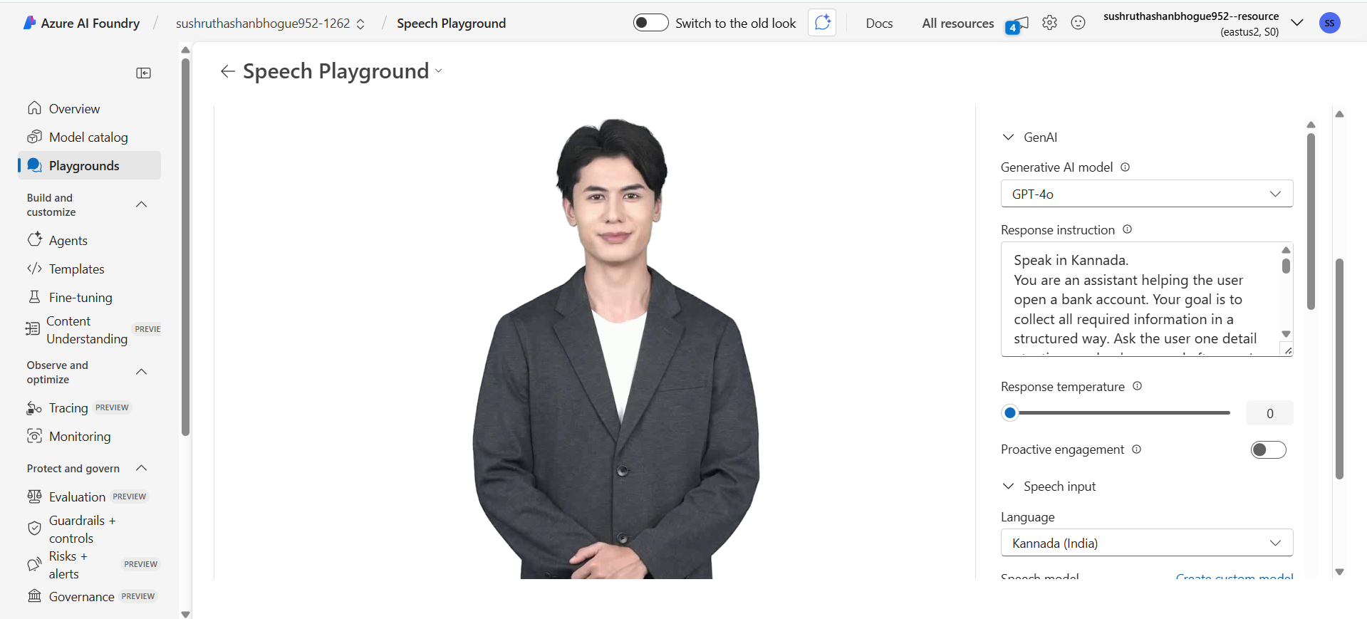
Project Design
Figure 1: Azure Speech Services
Department of CSE
13

Slide 14
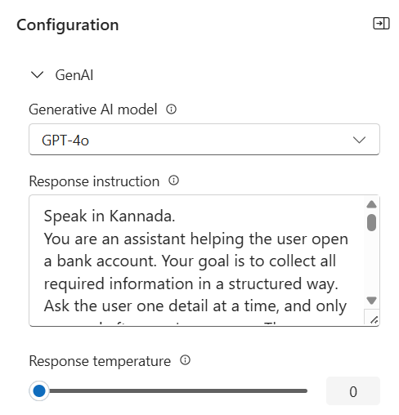
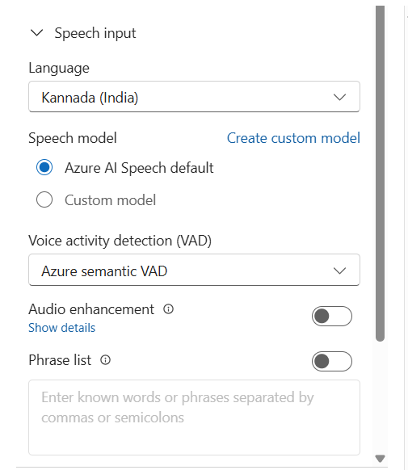
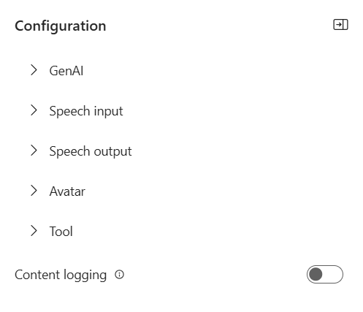
Project Design
Figure 2: Azure Avatar agent configuration
Department of CSE
14

Slide 15
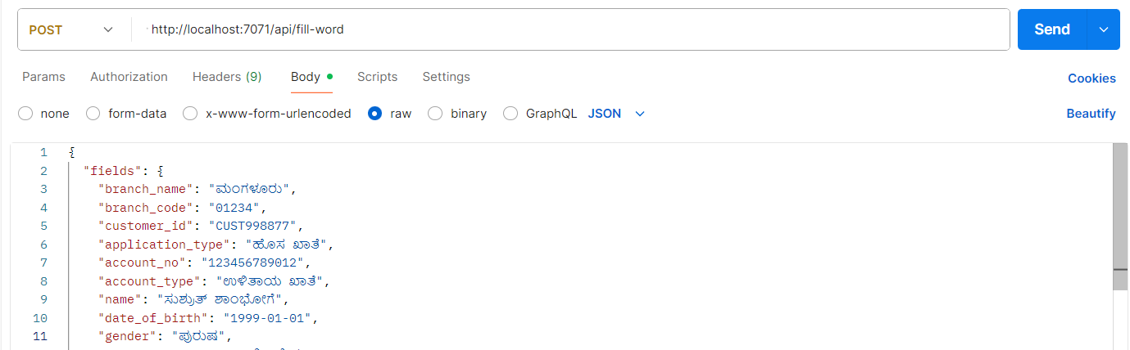
Project Design
Figure 4: Local Testing of Azure Function using Postman API
Department of CSE
15

Slide 16
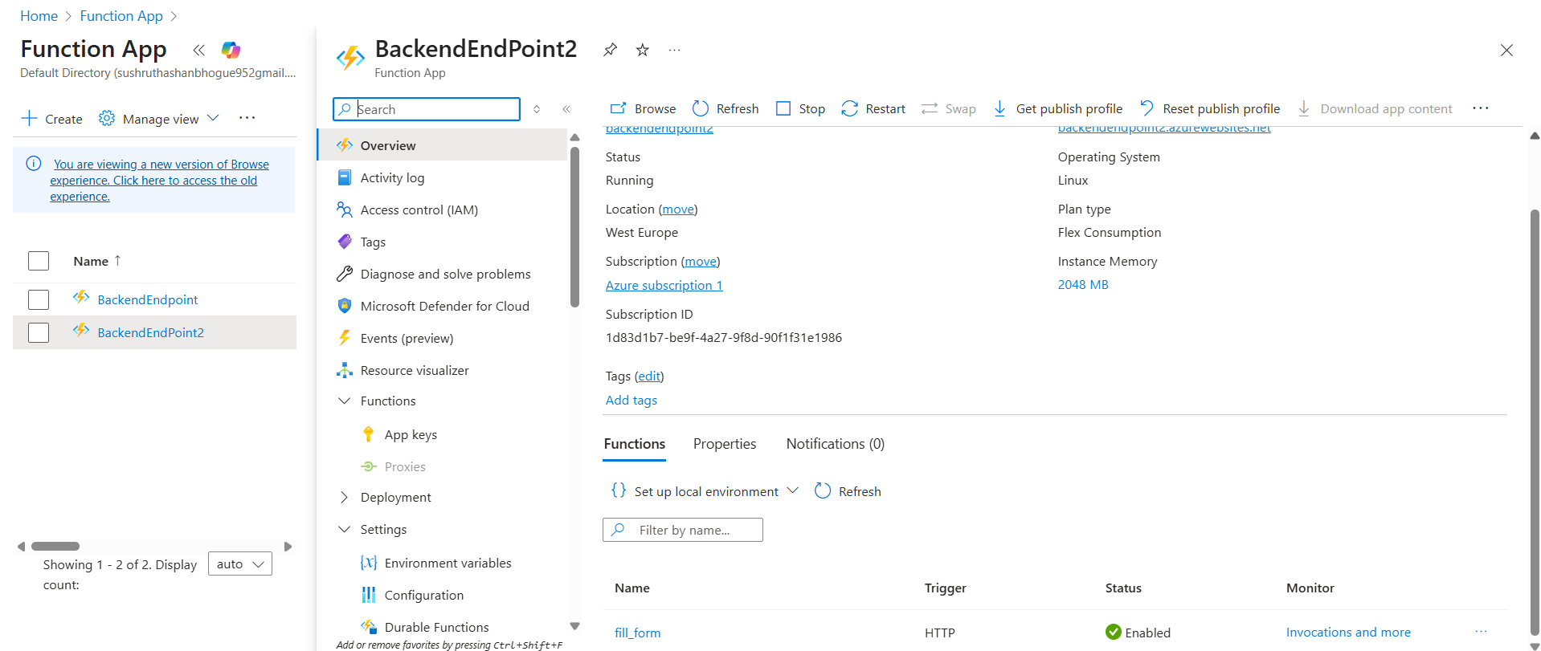
Project Design
Figure 5: Deploying the Python Script to Function App in Azure Portal
Department of CSE
16

Slide 17
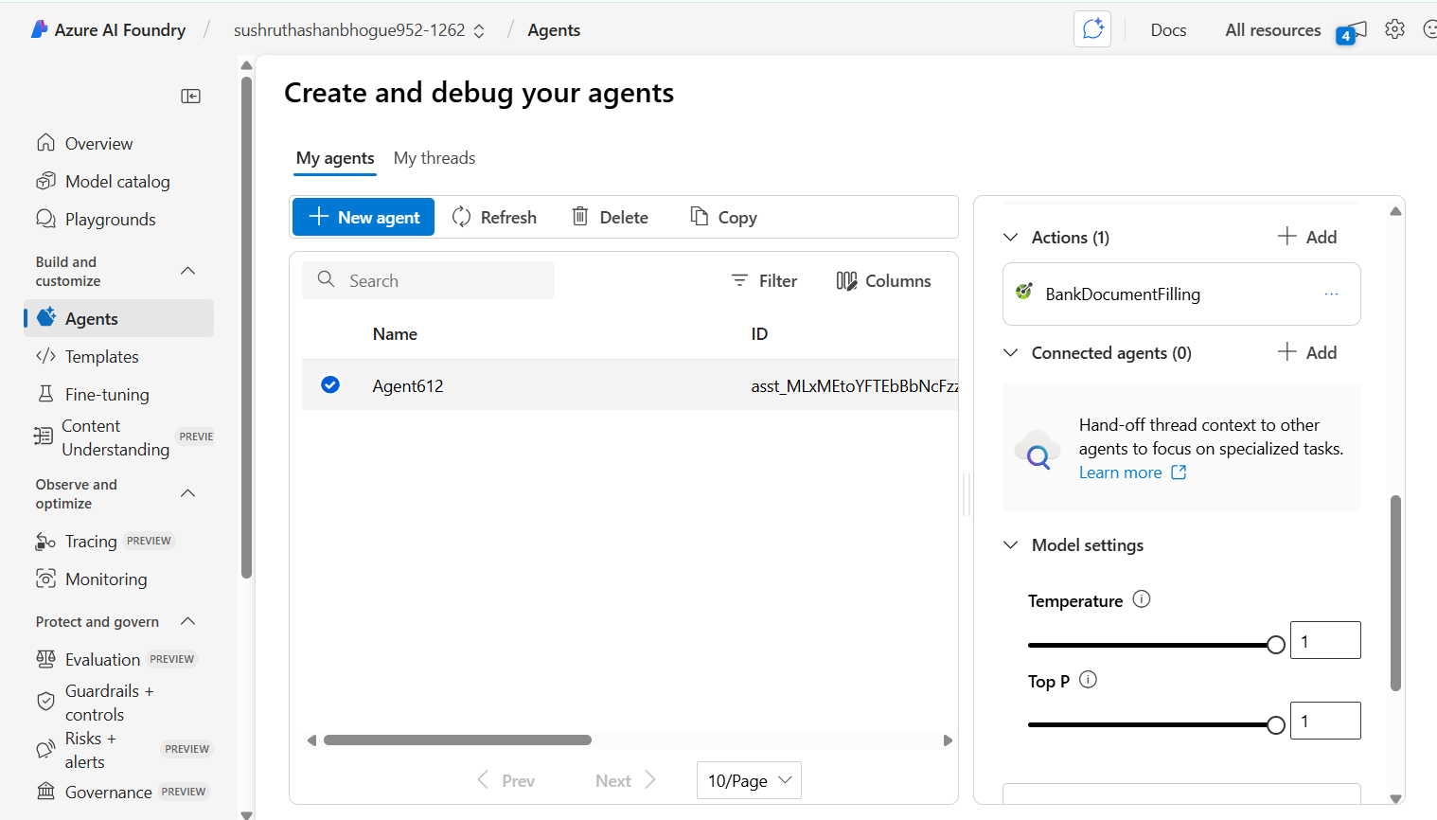
Project Design
Figure 6: Adding Deployment URL of Azure Function as action to avatar agent
Department of CSE
17

Slide 18
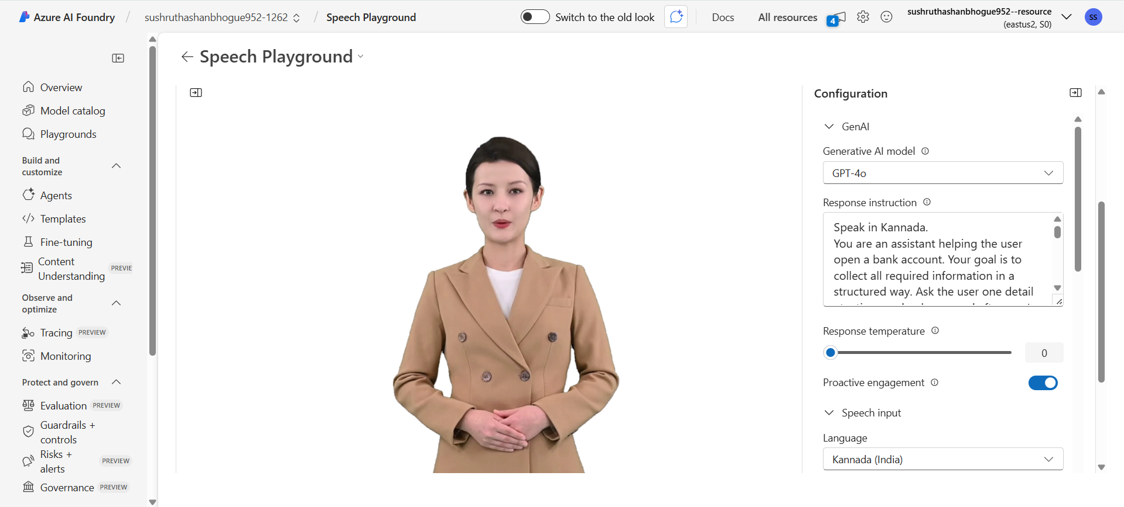
Project Design
Figure 7: Final Testing and Execution
Department of CSE
18

Slide 19
System Requirements Specification
FUNCTIONAL
REQUIREMENTS
The interactive azure avatar agent must accept the Kannada voice as input, transcribe and translate to English text, and fill the form fields of a custom bank application template
NON-FUNCTIONAL
REQUIREMENTS
Easy to use, even for non-literate users. Fast response (within 3–5 seconds).Noise-tolerant and secure. Scalable for more languages
HARDWARE
REQUIREMENTS
Client: Android phone/PC with mic/speaker, 2 GB RAM Server: CPU: Minimum 4 GB RAM
SOFTWARE
REQUIREMENTS
Python 3.8+, Microsoft Azure Account, VSCode
Department of CSE
19

Slide 20
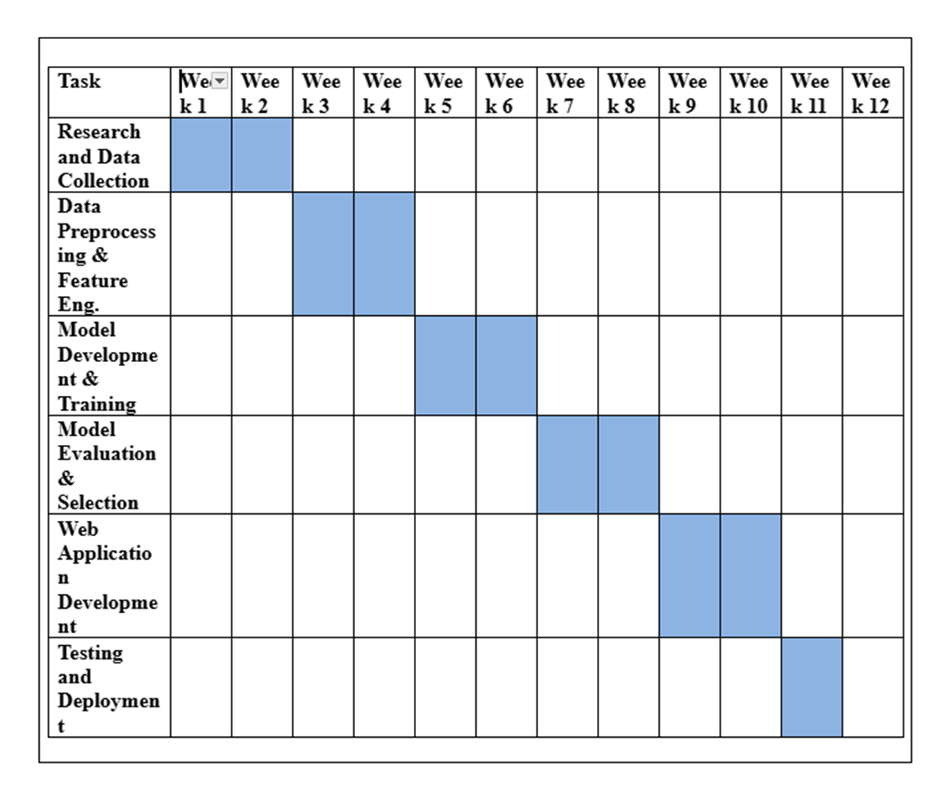
Gantt Chart
Department of CSE
20

Slide 21

RESULTS
Figure: Final azure avatar testing and execution

Slide 22
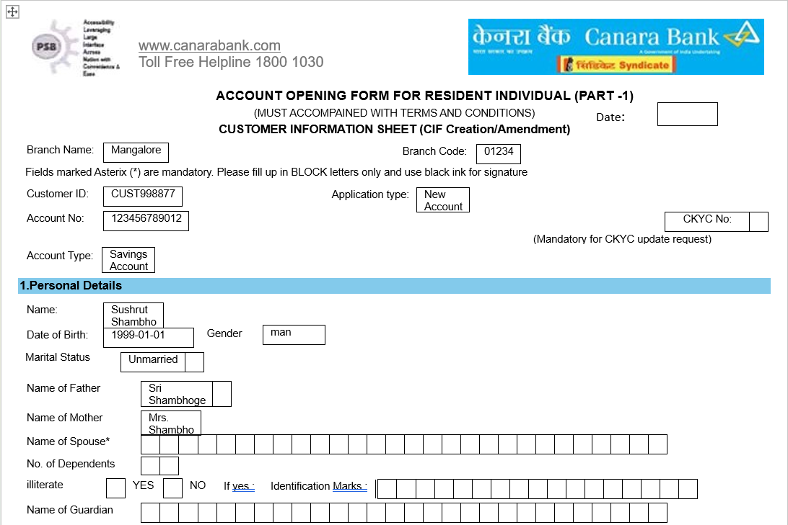
Figure 12: The bank application after filling first few fields

Slide 23
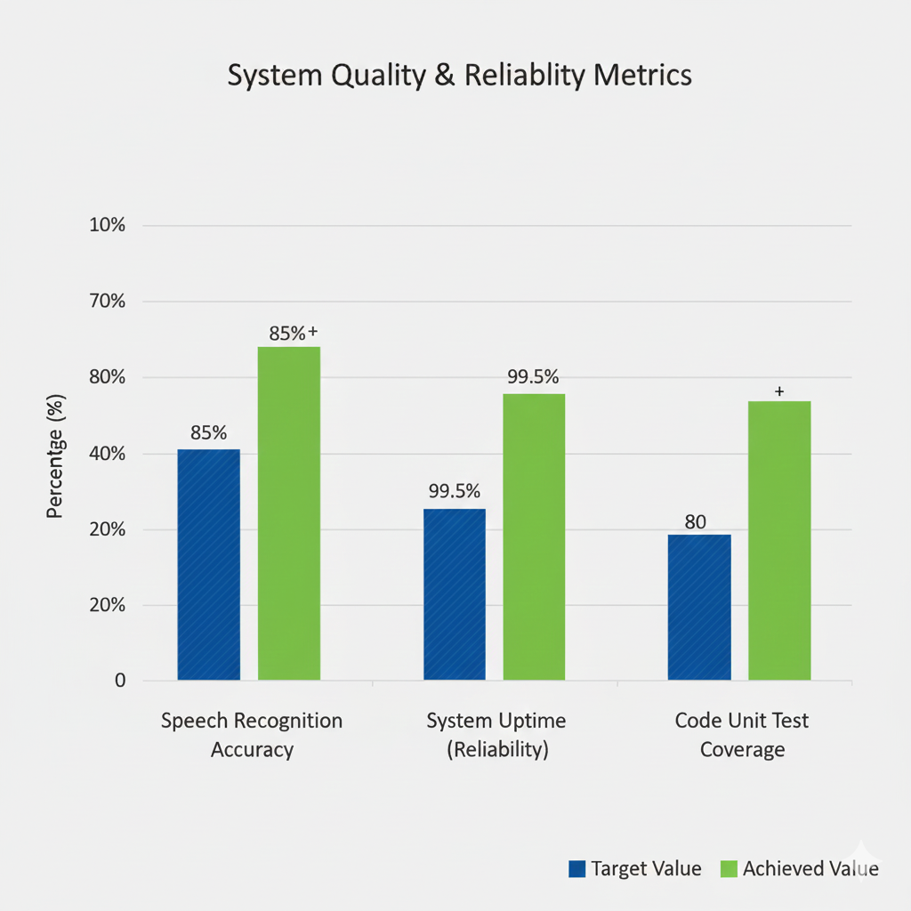
RELIABILITY METRICS ACHIEVED
Fig 13: System Quality and Reliability Metrics

Slide 24
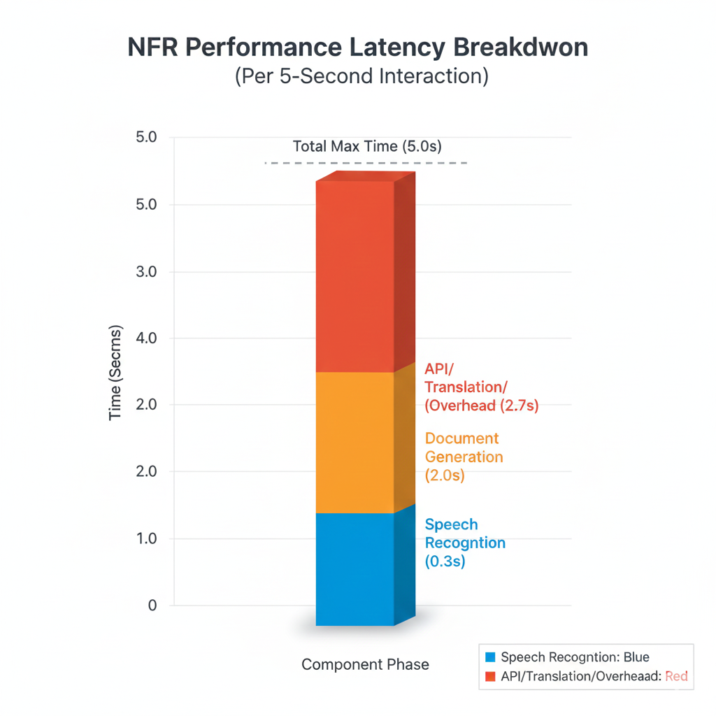
PERFORMANCE
Fig 14:Performance Latency Breakdown

Slide 25
Conclusion
The Voice-Based Banking System using Azure Services successfully demonstrates how artificial intelligence and cloud technologies can simplify banking for regional-language users. By integrating Azure Speech Service, Translator, AI Avatar, and Azure Functions, the system enables Kannada-speaking users to fill bank forms easily through voice interaction. It eliminates the need for English literacy or manual data entry, making the process faster, accurate, and user-friendly.This project promotes digital and financial inclusion, proving that AI-powered voice systems can bridge language barriers and bring modern banking services closer to rural communities
25

Slide 26
[1] A. Vaswani et al., “Attention is all you need,” in Proc. Adv. Neural Inf. Process. Syst. (NeurIPS), vol. 30, Dec. 2017, pp. 5998–6008.
[2] L. Ouyang et al., “Training language models to follow instructions with human feedback,” in Proc. Adv. Neural Inf. Process. Syst. (NeurIPS), vol. 35, Dec. 2022, pp. 27730–27744.
[3] S. C. Mathew, “The impact of digital financial services on financial inclusion in India: An empirical study,” J. Emerg. Market Finance, vol. 21, no. 1, pp. 77–100, Feb. 2022.
[4] J. Devlin et al., “BERT: Pre-training of deep bidirectional transformers for language understanding,” in Proc. Conf. North Amer. Chapter Assoc. Comput. Linguist., Hum. Lang. Technol. (NAACL-HLT), Jun. 2019, pp. 4171–4186.
[5] J. Wei et al., “Chain-of-thought prompting elicits reasoning in large language models,” in Proc. Adv. Neural Inf. Process. Syst. (NeurIPS), vol. 35, Dec. 2022, pp. 24824–24837.
References
Department of CSE
26

Slide 27
[6] A. Demirgüç-Kunt et al., “Measuring financial inclusion and the fintech revolution,” World Bank Econ. Rev., vol. 37, no. 2, pp. 315–334, Apr. 2023.
[7] A. Radford et al., “Improving language understanding by generative pre-training,” in Proc. Int. Conf. Mach. Learn. (ICML) Workshops, Jul. 2018
[8] T. Brown et al., “Language models are few-shot learners,” in Proc. Adv. Neural Inf. Process. Syst. (NeurIPS), vol. 33, Dec. 2020, pp. 1877–1901.
[9] P. Sharma and R. K. Gupta, “Overcoming language barriers in FinTech for rural development: A case study of India,” Inf. Technol. Develop., vol. 29, no. 1, pp. 128–147, Jan. 2023.
[10] A. Baevski et al., “wav2vec 2.0: A framework for self-supervised learning of speech representations,” in Proc. Adv. Neural Inf. Process. Syst. (NeurIPS), vol. 33, Dec. 2020, pp. 12449–12460.
Department of CSE
27

Slide 28
Thank You
Department of CSE
28

